Slide 1






Strictly Private and Confidential
Not for Onward Distribution
For Discussion Purposes Only
SECURITIES DIVISION
高盛技术分析部
“振荡和 …
… 平均回归研究”
中国外汇管理局技术分析交流会
北京 – 2011年9月6日，星期二
Prepared by a Goldman Sachs sales and trading desk, which may have a position in the products mentioned that is inconsistent with the views expressed in this material. In evaluating this material, you should know that it could have been previously provided to other clients and/or internal Goldman Sachs personnel, who could have already acted on it. This material is not independent advice and is not a product of Global Investment Research.
This material is intended for educational purposes only. This does not constitute an offer or solicitation with respect to the purchase or sale of any security in any jurisdiction in which such an offer or solicitation is not authorized or to any person to whom it would be unlawful to make such offer or solicitation.
The non-English translation of this material has been provided for your convenience and information only. We make no representations as to the accuracy and/or completeness of the translation. In the event of any inconsistency between the non-English version of this material and the English version, the English version shall prevail.

Slide 2


简单移动平均: 定义…
一个移动平均是指一段时间（x）内的算术平均线，通常以收盘价作为计算值。
计算移动平均的数据组总是在不断地向前滚动，因为总是从就近的时间段（x）内求得的结果。
Past performance is not an indicator of future results. Future returns are not guaranteed, and a loss of original investment may occur.
Foreign Exchange Strategies - From the Trading Desk

Slide 3
简单移动平均: 基本原则…
大量时间用于讨论移动平均的回测和优化，这两个过程的问题是它们可能会导致主观性和数据挖掘。
因此，为了保证客观性，最好的方法就是坚持运用约定俗成的移动平均线。
为了避免主观性，建议保证在整个图表的时间框架下保证周期是一个常数。
在外汇分析中拥有良好历史记录的移动平均周期有：
    21-周期 - 斐波纳契数列的一部分 (参见下表)
    55-周期 -斐波纳契数列的一部分 (参见下表), 最为有用的一个周期，尤其常用于外汇分析
    100-周期 – 市场接受的标准
    200-周期 – 市场接受的长期标准
斐波纳契数列中的每一个数字都是前二个数字的和，假设数列开始于0, 1。
0, 1, 1, 2, 3, 5, 8, 13, 21, 34, 55, 89….
Past performance is not an indicator of future results. Future returns are not guaranteed, and a loss of original investment may occur.
Foreign Exchange Strategies - From the Trading Desk

Slide 4
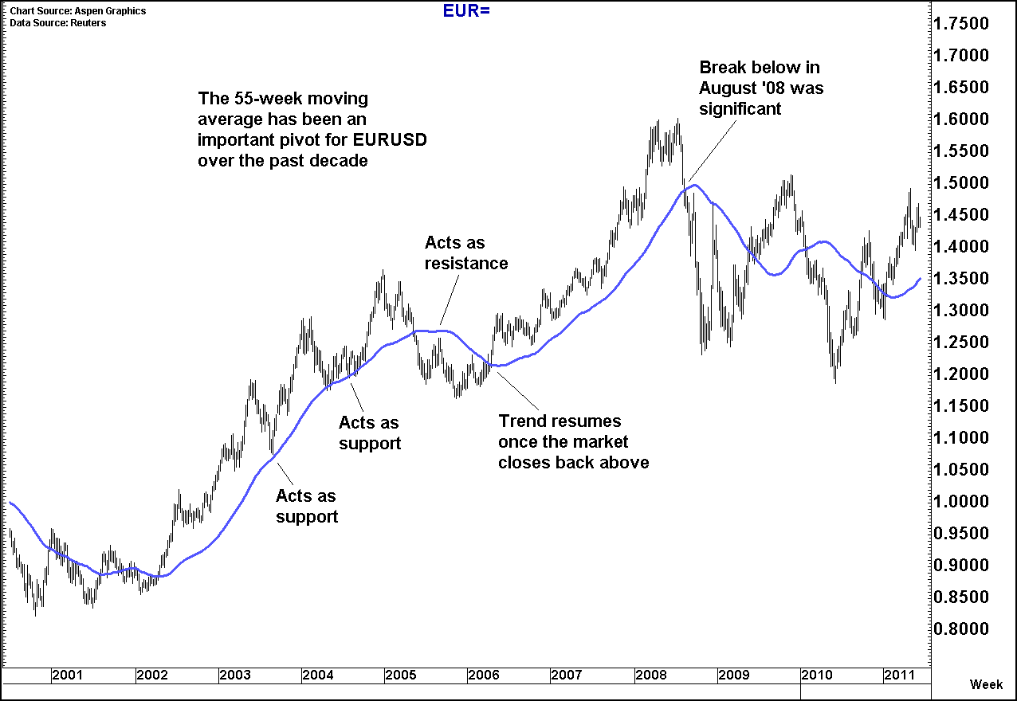
简单移动平均: 支撑位和阻力位…
可利用其它类型的市场基准点（上一个最高点、最低点等），计算移动平均线作为支撑位和阻力位。
因此，尤其在高于或低于移动平均线的交易持续较长的时期后，市场收盘价穿过某一均线是很值得注意的（在下一页会作详细讨论）。
当市场进行区间交易时，收盘价穿过移动平均线的意义就没有那么重大。
55周移动平均线在过去几十年钟对欧洲美元一直是一个重要的基准点；55天移动平均也十分有用。
Chart Source: Aspen Graphics Data: Reuters
Past performance is not an indicator of future results. Future returns are not guaranteed, and a loss of original investment may occur.
Foreign Exchange Strategies - From the Trading Desk

Slide 5
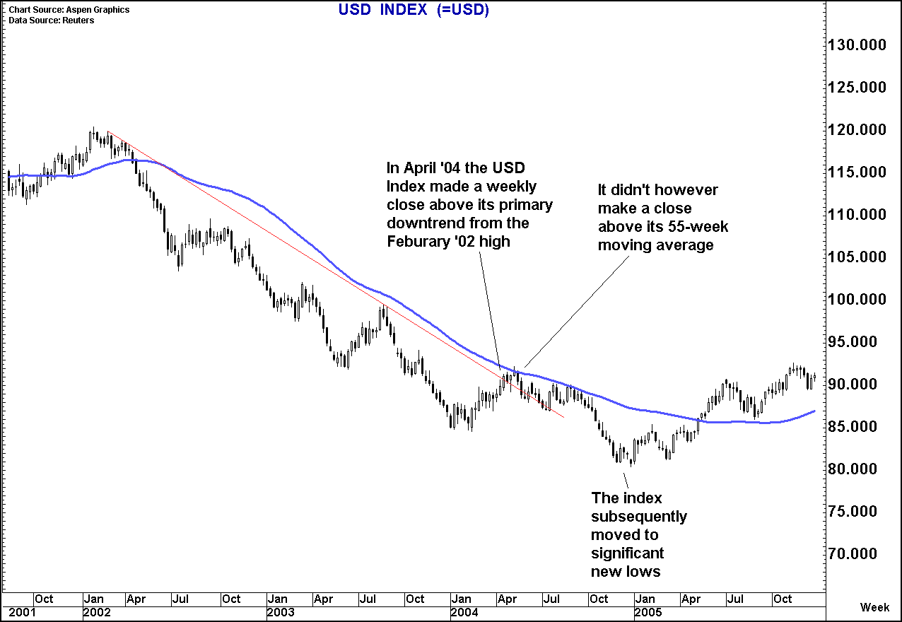
简单移动平均: 为什么优于简单趋势?..
市场趋势不会匀速渐变，换句话说，横向整理期或趋势减弱并不意味着趋势的结束。
要谨记这一点，突破简单线性趋势线常常会给出错误的信号，因为这些突破可能只是发生在整理期。
而移动平均的倾斜度终将适应（上升/下降）潜在的价格行为趋势。
55周的移动平均并未在04年中期给出美元指数的错误拐点信号，但从02年高点的简单趋势来看，却会产生误导。
Chart Source: Aspen Graphics Data: Reuters
Past performance is not an indicator of future results. Future returns are not guaranteed, and a loss of original investment may occur.
Foreign Exchange Strategies - From the Trading Desk

Slide 6
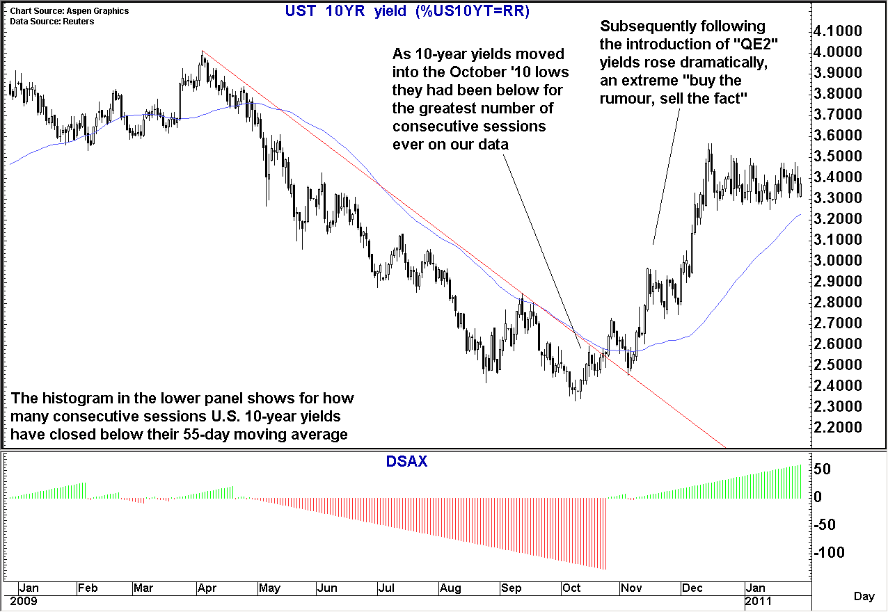
简单移动平均: 位于平均线以上/以下的周期…
除了仅仅作为阻力位和支撑位以外，移动平均还可以提供大量其它信息。
衍生物分析当中最有用/最有趣的一种是观察市场处于某一条移动平均线以上或以下一连有多少个周期。
在外汇分析领域，这类分析通常使用的移动平均周期是55天。
关于“第二轮量化宽松”的传言四起，美债收益重挫。
就在正式宣布“第二轮量化宽松”之前，连续多日美债收益都位于其55天移动平均线以下；官方消息发布之后，美债收益随之大幅跳涨。
Chart Source: Aspen Graphics Data: Reuters
Past performance is not an indicator of future results. Future returns are not guaranteed, and a loss of original investment may occur.
Foreign Exchange Strategies - From the Trading Desk
Chart Source: Aspen Graphics Data: Reuters

Slide 7
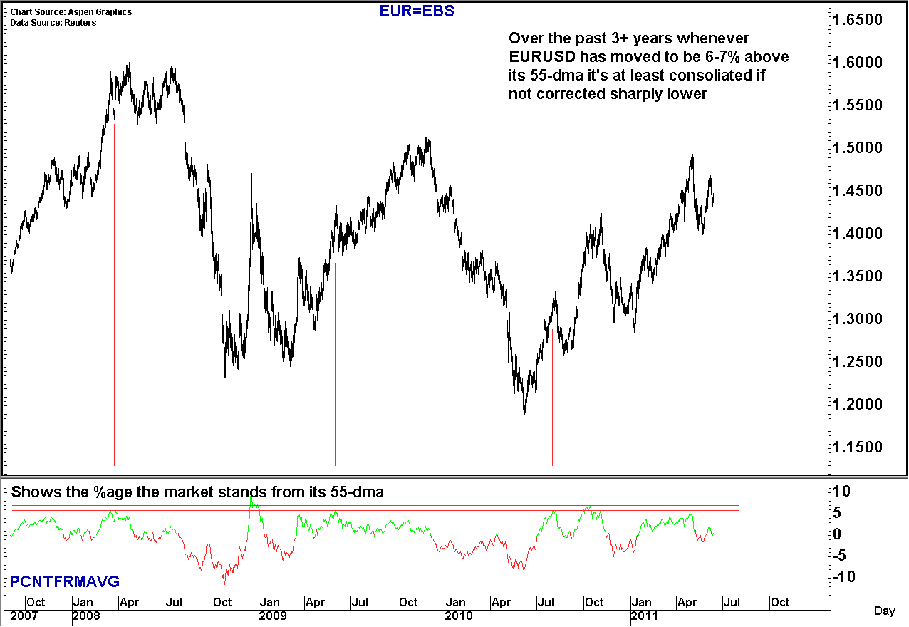
简单移动平均: 乖离率指标…
另一个相似的“延伸（stretched）”指标是移动平均原理派生的一项技术指标，即市场高于或低于该移动平均百分之几。
在计算高于/低于移动平均的连续周期数时，会再次用到55天移动平均，作为这一研究的基础。
以欧洲美元为例，过去四年当中，市场很难向上突破55天移动平均以上6-7%。
一旦价格在此区间徘徊时间过长，市场通常就会进入整理期或矫正期。
Chart Source: Aspen Graphics Data: Reuters
Past performance is not an indicator of future results. Future returns are not guaranteed, and a loss of original investment may occur.
Foreign Exchange Strategies - From the Trading Desk

Slide 8
“聚合” 和“聚类”的概念…
dictionary.com上对于“聚合”的解释
  “1. 倾向于在某个点或某条线上汇合; 非平行线朝着对方的方向倾斜；
  2. 倾向于有一个共同的结果或结论。”
http://dictionary.reference.com/browse/converged
不论何时，进行技术分析或基本面分析的关键目标之一就是增加自己对某一观点的信心 – 也就是“构建观点”。
同样的主题可应用于从无到有构建一个观点的全过程，以及其中的每一步。
何时应用这一概念呢，最重要的时机之一就是在寻找基准点的时候。
如果市场突破或未能突破某一基准点，你想要确定这是一个重要信号。
为了确定这一点，最好的办法就是寻找聚类，即，如果市场能够突破聚集/聚合在狭窄区间内的移动平均线、上扬趋势、先前低点和斐波纳契回调线，这很可能是一个更加重要的信号。
所以总而言之，使用移动平均最有力的方法就是当它们与其它类型的支撑和阻力（趋势等）聚类在一起的时候。如果本来聚在一起的主要趋势和“有重要数据意义”的移动平均线出现分歧，这很可能就是一个重要的信号。
Past performance is not an indicator of future results. Future returns are not guaranteed, and a loss of original investment may occur.
Foreign Exchange Strategies - From the Trading Desk

Slide 9
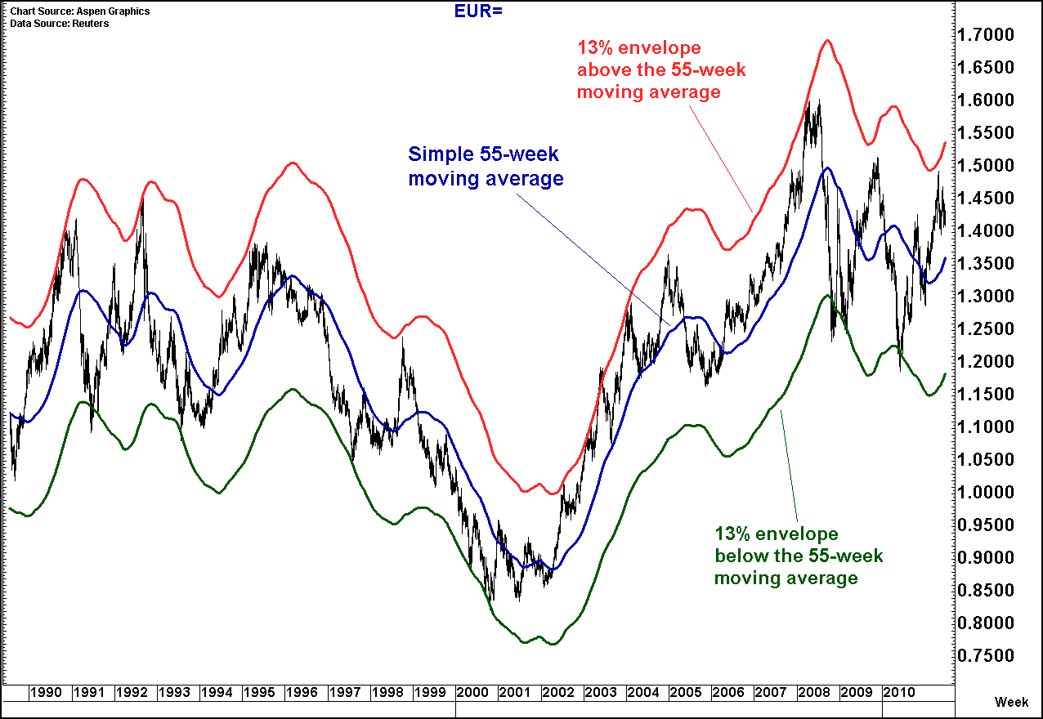
移动平均轨道: 简单而有效…
这实际上是一个均值回归指标，简单移动平均被作为居中水平，以其为基准上下移动同一个百分比而形成两条线，分别作为阻力位和支撑位。
简单的视觉回测常被用于选择移动平均线及设置轨道线百分比。更加技术性的方法是使用斐波拉契数列中的数字。（见第2页）
记住上面这些，现在来看右边的这幅图表，显示欧洲美元55周移动平均线及其上下13%封装线（13和55都是斐波拉契数字）。形成的轨道很好地显示了过去20年中的支撑和阻力。
Chart Source: Aspen Graphics Data: Reuters
Past performance is not an indicator of future results. Future returns are not guaranteed, and a loss of original investment may occur.
Foreign Exchange Strategies - From the Trading Desk

Slide 10
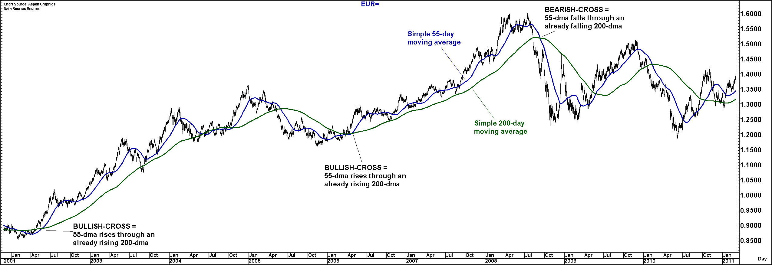
移动平均交汇点: 有用，但需严格…
另一个使用移动平均的简单衍生物分析。可使用的定义很多种，但同样，最终目的是为了尽可能地使信号变得明确。记住这一点，下面的规则就会很好用了：
牛市交叉点（BULLISH-CROSS） = 短期移动平均高于已处于上升趋势的长期平均
熊市交叉点（BEARISH-CROSS） = 短期移动平均低于已处于下降趋势的长期平均
将上述规则用于欧洲美元55天和200天移动平均线（在右边的图表中分别用蓝色和绿色标出），在过去10年当中一直十分灵验。
Chart Source: Aspen Graphics Data: Reuters
Past performance is not an indicator of future results. Future returns are not guaranteed, and a loss of original investment may occur.
Foreign Exchange Strategies - From the Trading Desk

Slide 11
布林通道: 波动校正的轨道线…
首先，布林通道如果孤立使用可能并无太大价值，即，它必须被作为“构建观点”过程中的一个要素
如果单独使用的话，布林通道很可能会给出过于频繁的买卖信号，导致止盈前过早平仓或过早逆势建仓。
总而言之，可将该指标用于信号检验，但不要将其本身作为买卖信号。
布林通道是如何算出的
计算布林通道的方法分为六个步骤，其中涉及两个变量； ‘x’是用于计算布林通道移动平均线的天数， ‘y’是轨道偏离移动平均线的标准差数量。
  计算时期‘x’内的算术平均数，用作移动平均
  从单个数值中减去算术平均数，求得原始离差。
  将原始离差平方，求得方差；
  将所有方差相加，得到方差算术和。
  用方差算术和除以数值个数，求得平均方差
  将平均方差开方，求得标准差。
将布林通道运用于市场，还需要在价格行为基础上标出以下三个数值：
  ‘x’ 时段内的简单移动平均
  简单移动平均加上‘y’倍标准差
  简单移动平均减去‘y’倍标准差
决定 ‘x’ 和 ‘y’
  ‘x’ 布林线默认设置‘x’为20 （即：20天简单移动平均）
  ‘y’ 布林线默认设置‘y’ 为2 （即：偏离移动平均2个标准差的区间内）
Past performance is not an indicator of future results. Future returns are not guaranteed, and a loss of original investment may occur.
Foreign Exchange Strategies - From the Trading Desk

Slide 12
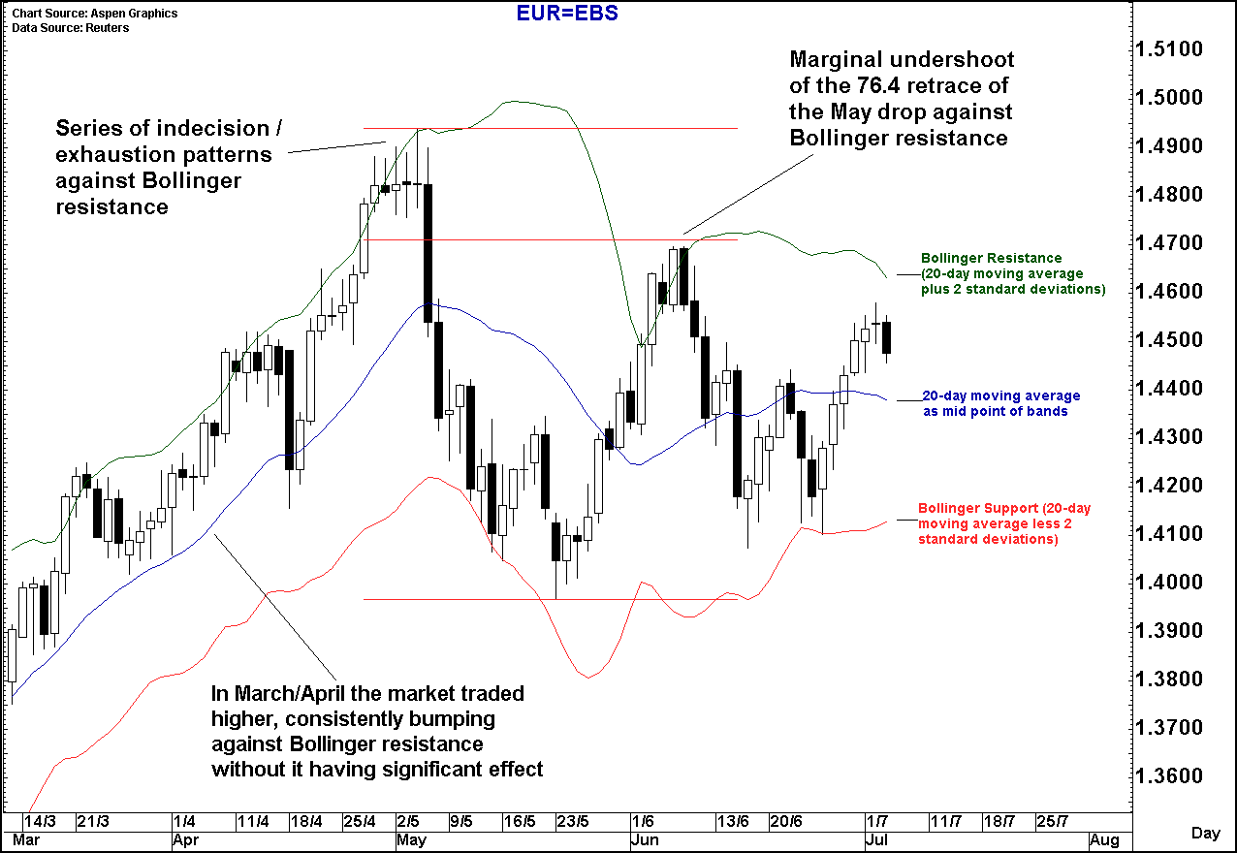
布林通道: 用于图表…
正如在上一张幻灯强调的，使用布林通道一定是在“构建观点”的过程中。
当市场出现趋势反转或衰竭形态，且试探上下轨道线时，布林通道是最为有力的工具。
右边的图表显示了近来欧洲美元的每日价格变动。强烈信号出现在(i)五月初高点，欧洲美元受到布林线阻力，显示了一系列徘徊和衰竭形态，而后(ii)六月初市场达到的高点，折返至五月跌幅的76.4%处，再次检验了布林线的阻力位。
Chart Source: Aspen Graphics Data: Reuters
Past performance is not an indicator of future results. Future returns are not guaranteed, and a loss of original investment may occur.
Foreign Exchange Strategies - From the Trading Desk

Slide 13
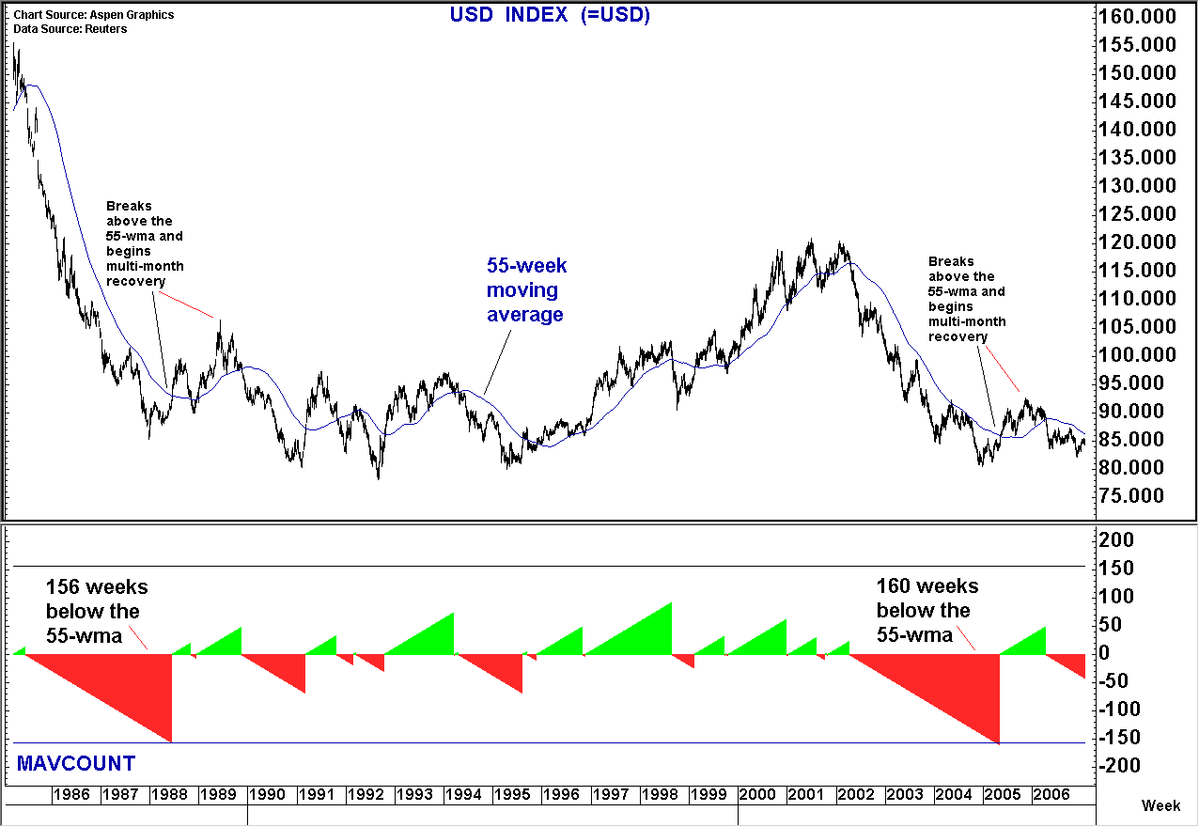
移动平均周期: 处于均线以上/以下的时段…
这是另一种使用移动平均的方法，即将其用作市场即将受到趋势中校正或转折影响的预警。
决定使用什么周期有两种方法: 一是靠数学，即斐波拉契数字；二是靠经验。
当分析师需要大规模使用指标时，都会存在“数据挖掘（DATA MINING）”和“牵强附会（MAKING IT FIT）”的风险。
从历史上来看值得跟踪的周期/关系：市场一度连续3年以上一直高于/低于其55周移动平均，会更容易受到重要的转折或校正的影响。
Chart Source: Aspen Graphics Data: Reuters
Past performance is not an indicator of future results. Future returns are not guaranteed, and a loss of original investment may occur.
Foreign Exchange Strategies - From the Trading Desk

Slide 14
振荡器: 原则…
振荡器是技术分析的一种衍生形式。其主要目的是提高与交易决策相关的风险/回报，并作为市场即将受到转折或校正的早期预警。
有以下两种主要的应用方式:
作为“超买”或“超卖”指标
作为衰竭信号，即会产生正背离或负背离
Past performance is not an indicator of future results. Future returns are not guaranteed, and a loss of original investment may occur.
Foreign Exchange Strategies - From the Trading Desk

Slide 15
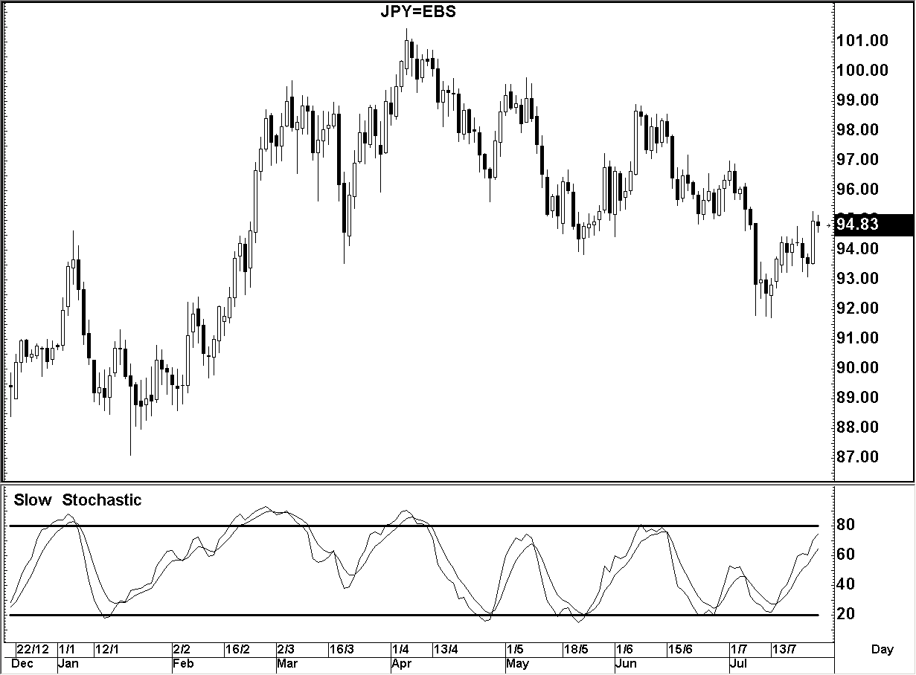
振荡器: 慢速随机指标 (作为买入/卖出信号)…
慢速随机指标的公式:
买入/卖出信号 (即：风向/回报指标)
下图中超过-20，或接近于0，理论上标志着市场已经被超买；低于-80，或接近于-100，理论上标志市场已被超卖。一旦指标移动到这些极端的水平，就应该从经典指标中留意市场准备转向的信号。与其它振荡器一样，图表所基于的时间周期越长，信号的重要性越高：日内<每天<每周 <每月
Slow %K Line
3 period modified moving average of the below
100 x
(current close - lowest low in n periods)
(highest high in n periods - lowest low in n periods)
Slow Stochastics have worked well as an oscillator on USDJPY over recent months
Slow %D Line
3 period modified moving average of the Slow %K Line
但最重要的并不是知道公式本身，而是知道如何解读指标。
对于这一指标输入有很多不同的“市场标准”，最常用的是9/3/3，分别代表上述公式中的 ‘n’，和移动平均的周期。
保持输入参数不变，以避免数据挖掘，即保持分析是客观的。
Chart Source: Aspen Graphics Data: Reuters
Past performance is not an indicator of future results. Future returns are not guaranteed, and a loss of original investment may occur.
Foreign Exchange Strategies - From the Trading Desk

Slide 16
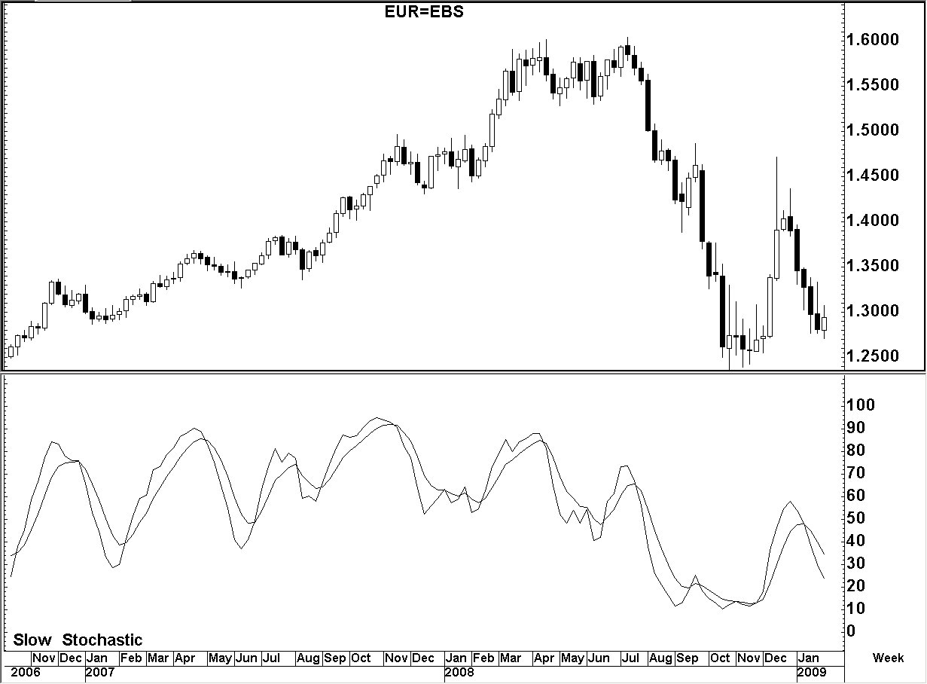
振荡器: 慢速随机指标 (作为衰竭信号)…
慢速随机指标的公式:
衰竭指标 (或 +VE AND –VE DIVERGENCE)
该信号会在趋势市场中产生，但表明这个趋势正在失去势头，变得越来越平。通常与楔型形态有关。有两种形式的背离:
正背离:市场价格行为连续出现了超过2个以上较低的低点，而振荡器上相应地出现了超过2个以上的较高的低点，就形成了负背离。
负背离:市场价格行为连续出现了超过2个以上较高的高点，而振荡器上相应地出现了超过2个以上较低的高点，就形成了负背离。
从历史上看，当在极端趋势下，一连出现3个背离高点/低点时，该指标是最可靠的。
Slow %K Line
3 period modified moving average of the below
100 x
(current close - lowest low in n periods)
(highest high in n periods - lowest low in n periods)
Slow %D Line
3 period modified moving average of the Slow %K Line
但最重要的并不是知道公式本身，而是知道如何解读指标。
对于这一指标输入有很多不同的“市场标准”，最常用的是9/3/3，分别代表上述公式中的 ‘n’，和移动平均的周期。
保持输入参数不变，以避免数据挖掘，即保持分析是客观的。
EURUSD developed triple negative weekly divergence against the 1.6040 highs in July ‘08
Chart Source: Aspen Graphics Data: Reuters
Past performance is not an indicator of future results. Future returns are not guaranteed, and a loss of original investment may occur.
Foreign Exchange Strategies - From the Trading Desk

Slide 17
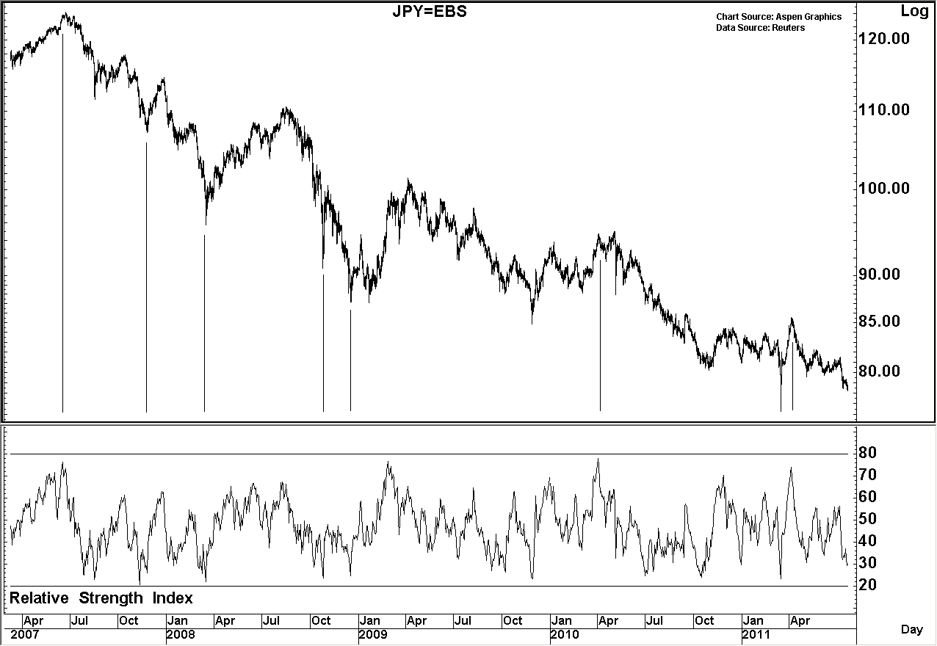
振荡器: RSI – 相对强弱指数(作为买入/卖出信号)…
相对强弱指数的公式：
买入/卖出信号 (即：风向/回报指标)
下图中超过-20，或接近于0，理论上标志着市场已经被超买；低于-80，或接近于-100，理论上标志市场已被超卖。一旦指标移动到这些极端的水平，就应该从经典指标中留意市场准备转向的信号。与其它振荡器一样，图表所基于的时间周期越长，信号的重要性越高：日内<每天<每周 <每月
RSI =
100
1 + RS
RS =
modified moving average of X day’s up closes
Although not 100% reliable readings of near 80 or 20 have been reasonable signals that USDJPY is at risk of reversal/correction
Modified moving average of X day’s down closes
同样，最重要的是知道如何解读指标。
该指标在0到100之间。
创立者最初建议使用14-周期体统
Chart Source: Aspen Graphics Data: Reuters
Past performance is not an indicator of future results. Future returns are not guaranteed, and a loss of original investment may occur.
Foreign Exchange Strategies - From the Trading Desk

Slide 18
振荡器: MACD – 定义(作为衰竭信号)…
MACD(移动平均数汇总/分离指标)公式 :
MACD可被用作超买/超卖的指标，与慢速随机指标或相对强弱指数类似，但是更经常被用于寻找背离
虽然公式看上去很复杂，其潜在的理论是十分简单的，就是有效反映了两个移动平均之间差异的柱状图。
简单的说，它可以让你直观地评估趋势的健康状况。
虽然就此还仍然有待讨论，简单的讲，这意味着存在两个市场状态（同样也可用于牛势和熊势。）
    健康的趋势– 移动平均之间的差异保持着稳定，或逐步增大，即趋势的势头是稳定或加强的。
    不健康的趋势 –移动平均之间的差异是萎缩的，即趋势的势头正在减弱。
MACD
EMA1_{t} – EMA2_{t}
Signal Line
MACD_{t-1} + SLSF (MACD_{t} – MACD_{t-1})
Exponential Moving Average 1
EMA1_{t-1} + SF1 (P_{t} – EMA1_{t-1})
Exponential Moving Average 2
EMA2_{t-1} + SF2 (P_{t} – EMA2_{t-1})
EMA1_{t}
current value of 1st exponential moving average
EMA2_{t}
current value of 2nd exponential moving average
EMA1_{t-1}
previous value of 1st exponential moving average
EMA2_{t-1}
previous value of 2nd exponential moving average
SF1
smoothing factor for EMA1
SF2
smoothing factor for EMA2
MACD_{t}
current MACD value
MACD_{t-1}
previous MACD value
SLSF
SLSF = signal line smoothing factor
Past performance is not an indicator of future results. Future returns are not guaranteed, and a loss of original investment may occur.
Foreign Exchange Strategies - From the Trading Desk

Slide 19
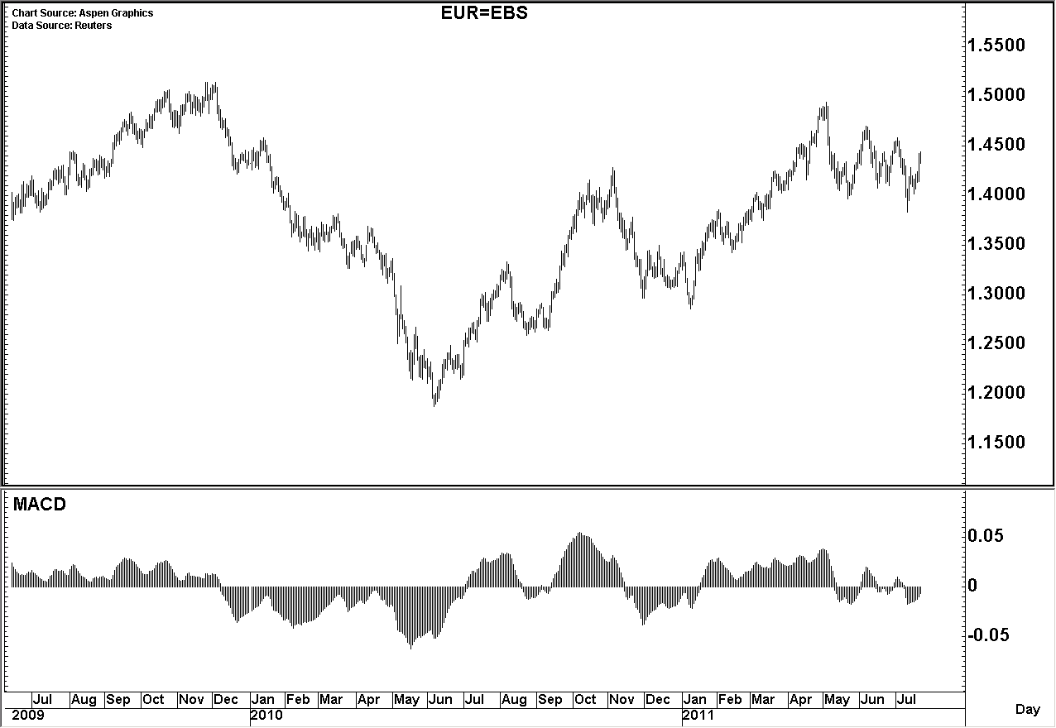
振荡器: MACD – 应用(衰竭信号)…
衰竭信号 (I.E. +VE AND –VE 背离)
EURUSD 该信号会在趋势市场中产生，但表明这个趋势正在失去势头，变得越来越平。通常与楔型联系起来。两种形式的背离均在最近欧洲美元的例子当中有所体现。
负背离
市场价格行为连续出现了超过2个以上的高点，而MACD柱形图上相应地出现了超过2个以上的较低的高点，就形成了负背离。
正背离
市场价格行为连续出现了超过2个以上较低的低点，而MACD柱形图上相应地出现了超过2个以上的较高的低点，就形成了负背离。
Negative Divergence
Positive Divergence
Negative Divergence
Positive Divergence
Chart Source: Aspen Graphics Data: Reuters
Past performance is not an indicator of future results. Future returns are not guaranteed, and a loss of original investment may occur.
Foreign Exchange Strategies - From the Trading Desk

Slide 20
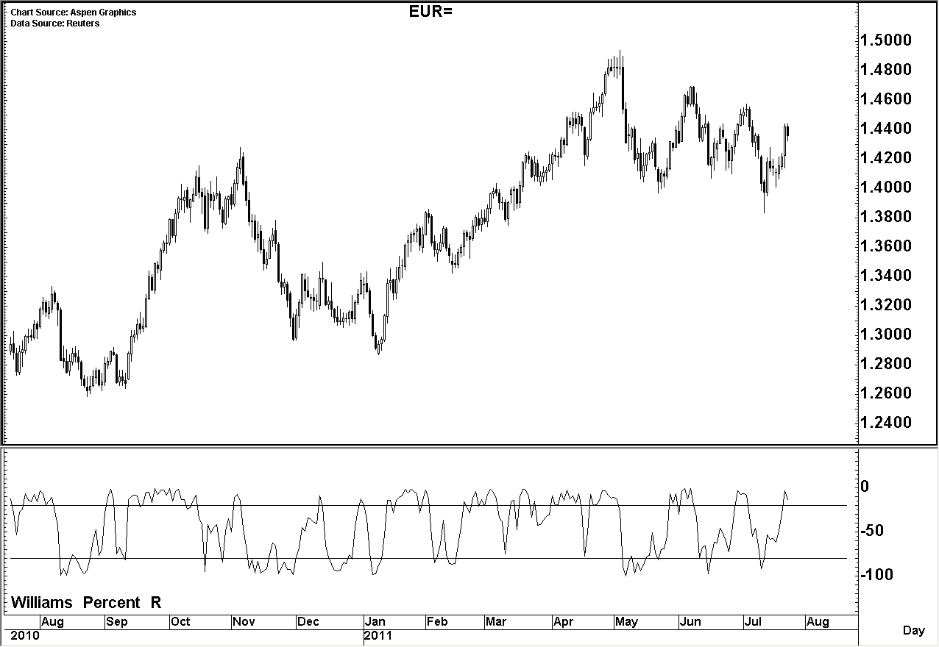
振荡器: 威廉指标 (作为买入/卖出信号)…
威廉指标的公司:
买入/卖出信号 (即：风向/回报指标)
下图中超过-20，或接近于0，理论上标志着市场已经被超买；低于-80，或接近于-100，理论上标志市场已被超卖。一旦指标移动到这些极端的水平，就应该从经典指标中留意市场准备转向的信号。与其它振荡器一样，图表所基于的时间周期越长，信号的重要性越高：日内<每天<每周 <每月
%R
high_{n} – 当前收盘价
low_{n} - high_{n}
n
_{周期数}
high_{n}
N个周期内的最高点
趋势市场，指标效果不佳
low_{n}
N个周期内的最低点
xx
该指标范围从0到100
作者建议的 ‘n’值为14.
与其它指标一样，要学会如何解读它们，而不是将其作为金科玉律。
该指标在区间市场比较有用，所以必须和其它指标相结合，才能帮助确定市场态势（区间或趋势）。
区间市场，指标效果较好
Chart Source: Aspen Graphics Data: Reuters
Past performance is not an indicator of future results. Future returns are not guaranteed, and a loss of original investment may occur.
Foreign Exchange Strategies - From the Trading Desk

Slide 21
Disclaimers
Product Specific Risk Disclosure
The ideas detailed in this presentation may involve the purchase of options, in this case the premium paid may be lost if favourable market movement for the structure concerned does not take place.
This message has been prepared by personnel in the Equities or Fixed Income, Currency and Commodities Sales/Trading Departments of one or more affiliates of The Goldman Sachs Group, Inc. ("Goldman Sachs") and is not the product of Goldman Sachs Global Investment Research. It is not a research report and is not intended as such.
Non-Reliance and Risk Disclosure: This material should not be construed as an offer to sell or the solicitation of an offer to buy any security in any jurisdiction where such an offer or solicitation would be illegal. We are not soliciting any action based on this material. It is for the general information of our clients. It does not constitute a recommendation or take into account the particular investment objectives, financial conditions, or needs of individual clients. Before acting on this material, you should consider whether it is suitable for your particular circumstances and, if necessary, seek professional advice. The price and value of the investments referred to in this material and the income from them may go down as well as up, and investors may realize losses on any investments. Past performance is not a guide to future performance. Future returns are not guaranteed, and a loss of original capital may occur. We do not provide tax, accounting, or legal advice to our clients, and all investors are advised to consult with their tax, accounting, or legal advisers regarding any potential investment. The material is based on information that we consider reliable, but we do not represent that it is accurate, complete and/or up to date, and it should not be relied on as such. Opinions expressed are our current opinions as of the date appearing on this material only and only represent the views of the author and not those of Goldman Sachs, unless otherwise expressly noted.
Limitations of statistical analysis: GS provides no assurance or guarantee that the investment will operate or would have operated in the past in a manner consistent with the statistical analysis presented in this document.
Risk Disclosure Regarding futures, options, equity swaps, and other derivatives as well as non-investment-grade securities and ADRs: Please ensure that you have read and understood the current options disclosure document before entering into any options transactions. Current United States listed options disclosure documents are available from our sales representatives or at http://theocc.com/publications/risks/riskstoc.pdf. Certain transactions - including those involving futures, options, equity swaps, and other derivatives as well as non-investment-grade securities - give rise to substantial risk and are not available to nor suitable for all investors. If you have any questions about whether you are eligible to enter into these transactions with Goldman Sachs, please contact your sales representative. This material is not for distribution to retail clients, as that term is defined under The European Union Markets in Financial Instruments Directive (2004/39/EC) and any investments, including derivatives, mentioned in this material will not be made available by us to any such retail client. Foreign-currency-denominated securities are subject to fluctuations in exchange rates that could have an adverse effect on the value or price of, or income derived from, the investment. In addition, investors in securities such as ADRs, the values of which are influenced by foreign currencies, effectively assume currency risk.
Special Risk Disclosure related to U.S. Registered Exchange-Traded Funds ("ETFs") and Exchange-Traded Notes ("ETNs"): To the extent this communication contains information pertaining to U.S. registered ETFs or ETNs, consider the investment objectives, risks, and charges and expenses of the ETFs and ETNs carefully before investing. Each ETF and ETN has filed a registration statement (including a prospectus) with the SEC which contains this and other information about the ETF or ETN as applicable. Before you invest in an ETF or ETN, you should obtain and read carefully the prospectus in the registration statement and other documents the issuer has filed with the SEC for more complete information about the product. You may get these documents for free by visiting EDGAR on the SEC website at www.sec.gov. Alternatively, you may obtain a copy of the prospectus for each of the ETFs and ETNs mentioned in these materials by (i) contacting your Goldman Sachs sales representative, or (ii) sending a request by calling toll-free 1-866-471-2526, or (iii) sending a request by email to Propsectus-ny@ny.email.gs.com, by fax to (212) 902-9316, or by mail to Goldman Sachs, 85 Broad Street, NY, NY, 10004, Attn: Prospectus Department.

Slide 22
Disclaimers
ETFs are redeemable only in Creation Unit size aggregations and may not be individually redeemed; are redeemable only though Authorized Participants; and are redeemable on an "in-kind" basis. The public trading price of a redeemable lot of the ETFs may be different from its net asset value. These ETFs can trade at a discount or premium to the net asset value. There is always a fundamental risk of declining stock prices, which can cause losses to your investment.
Most leveraged and inverse ETFs “reset” daily, meaning that they are designed to achieve their stated objectives on a daily basis. Due to the effect of compounding, their performance over longer periods of time can differ significantly from the performance (or inverse of the performance) of their underlying index or benchmark during the same period of time and as such are not meant to be held for the long term. This effect can be magnified in volatile markets. Prior to entering into a transaction in leveraged or inverse ETFs, you should be aware of the general risks associated with such transactions. You should not enter into leveraged or inverse ETFs transactions unless you understand the nature and extent of your risk exposure. You should also be satisfied that the leveraged or inverse ETFs transaction is appropriate for you in light of your circumstances and financial condition.
Order Handling Practices for Listed and Over-the-Counter Derivatives: While the firm is holding your derivative (e.g. options, convertible bonds, warrants or preferred shares) order, the firm or its clients may engage in trading activity in the same or related products, including transactions in the underlying securities. While such trading activity is unrelated to your order, it may coincidentally impact the price of the derivative that you are buying or selling.
Not a Valuation: Values herein are not customer valuations and should not be used in lieu of a customer valuation statement or account statement. These values may not reflect the value of the positions carried on the books and records of Goldman Sachs or its affiliates and should not be relied upon for the maintenance of your books and records or for any tax, accounting, legal or other purposes. The information provided herein does not supersede any customer statements, confirmations or other similar notifications.
ETFs and ETNs that are linked to commodity futures do not offer direct exposure to the commodity's spot price, and may perform differently than the spot price for the commodity itself. Performance differential can be magnified if a specific condition persists in the market for a commodity that creates a disparity between near-term future prices and long-term future prices and may lead to unexpected performance results. Other factors, such as roll yield, transaction costs, management fees, and taxes may cause deviation in performance between the spot price of a commodity and commodity futures. You should not assume that an ETF or ETN that is linked to commodity futures will provide an effective hedge because of a negative correlation with equities or other asset classes. You should always be aware of the general risks associated with investing in the commodities market and the futures market before investing in an ETF or ETN that is linked to commodity futures.
Not a Fiduciary: To the extent this material is provided to an employee benefit plan or account subject to the Employee Retirement Income Security Act of 1974 or Section 4975 of the Internal Revenue Code, this material is provided solely on the basis that it will not constitute investment advice and will not form a primary basis for any person's or plan's investment decisions, and nothing in this material will result in Goldman Sachs becoming a fiduciary with respect to any person or plan. To the extent this material is provided to any other recipient, this material is provided solely on the basis that the recipient has the capability to independently evaluate investment risk and is exercising independent judgment in evaluating investment decisions in that its investment decisions will be based on its own independent assessment of the opportunities and risks presented by a potential investment, market factors and other investment considerations.
Not a Municipal Advisor: Except in circumstances where Goldman Sachs expressly agrees otherwise, Goldman Sachs is not acting as a municipal advisor and the opinions or views contained herein are not intended to be, and do not constitute, advice, including within the meaning of Section 15B of the Securities Exchange Act of 1934.

Slide 23
Disclaimers
Disclosures for Third-Party Information/Data: This material may contain data or other information received from third parties which we consider reliable, but we do not represent that it is accurate or complete, and it should not be relied upon as such. Goldman Sachs in no way endorses or adopts any statement made in any such third party materials. Goldman Sachs shall have no liability, contingent or otherwise, to the user or to third parties, for the quality, accuracy, timeliness, continued availability or completeness of third party data or information nor for any special, indirect, incidental or consequential damages which may be incurred or experienced because of the use of this data, information or calculations made available herein, even if Goldman Sachs has been advised of the possibility of such damages.
Conflict of Interest Disclosure: We are a full-service, integrated investment banking, investment management, and brokerage firm. The professionals who prepared this material are paid in part based on the profitability of The Goldman Sachs Group, Inc., which includes earnings from the firm's trading, capital markets, investment banking and other business. They, along with other salespeople, traders, and other professionals may provide oral or written market commentary or trading strategies to our clients that reflect opinions that are contrary to the opinions expressed herein or the opinions expressed in research reports issued by our Research Departments, and our proprietary trading and investing businesses may make investment decisions that are inconsistent with the views expressed herein. In addition, the professionals who prepared this material may also produce material for, and from time to time, may advise or otherwise be part of our trading desks that trade as principal in the securities mentioned in this material. This material is therefore not independent from our proprietary interests, which may conflict with your interests. We and our affiliates, officers, directors, and employees, including persons involved in the preparation or issuance of this material, may from time to time have "long" or "short" positions in, act as principal in, and buy or sell the securities or derivatives (including options) thereof in, and act as market maker or specialist in, and serve as a director of, companies mentioned in this material. In addition, we may have served as manager or co manager of a public offering of securities by any such company within the past three years.
Legal Entities Disseminating this Material: This material is disseminated in Australia by Goldman Sachs & Partners Australia Pty Ltd (ABN 21 006 797 897) on behalf of Goldman Sachs; in Canada by Goldman, Sachs & Co. (or when expressly noted as such, by Goldman Sachs Execution & Clearing, L.P.) and by Goldman Sachs Administration Services (Canada) Co.; in Hong Kong by Goldman Sachs (Asia) L.L.C.; in Japan by Goldman Sachs Japan Co., Ltd.; in the Republic of Korea by Goldman Sachs (Asia) L.L.C., Seoul Branch; in New Zealand by Goldman Sachs & Partners New Zealand Limited on behalf of Goldman Sachs; in Singapore by Goldman Sachs (Singapore) Pte. (Company Number: 198602165W); in India by Goldman Sachs (India) Securities Private Limited, Mumbai Branch; in Ireland by Goldman Sachs Bank (Europe) Public Limited Company; in Europe by Goldman Sachs International (unless stated otherwise); in France by Goldman Sachs Paris Inc. et Cie and/or Goldman Sachs International; in Germany by Goldman Sachs International and/or Goldman, Sachs & Co. oHG; in the Cayman Islands by Goldman Sachs (Cayman) Trust, Limited; in Brazil by Goldman Sachs do Brasil Banco Múltiplo S.A.; and in the United States of America by Goldman, Sachs & Co. (or when expressly noted as such, by Goldman Sachs Execution & Clearing, L.P.) (both of which are members of FINRA, NYSE and SIPC) and by Goldman Sachs Bank USA. You may obtain information about SIPC, including the SIPC brochure, by contacting SIPC (website: http://www.sipc.org/; phone: 202-371-8300). Goldman Sachs International, which is authorized and regulated by the Financial Services Authority, has approved this material in connection with its distribution in the United Kingdom and European Union. Unless governing law permits otherwise, you must contact a Goldman Sachs entity in your home jurisdiction if you want to use our services in effecting a transaction in the securities mentioned in this material.
Reproduction and Re-Distribution: No part of this material may be (i) copied, photocopied or duplicated in any form by any means or (ii) redistributed without our prior written consent. Notwithstanding anything herein to the contrary, and except as required to enable compliance with applicable securities law, you (and each of your employees, representatives and other agents) may disclose to any and all persons the U.S. federal income and state tax treatment and tax structure of the transaction and all materials of any kind (including tax opinions and other tax analyses) that are provided to you relating to such tax treatment and tax structure, without Goldman Sachs imposing any limitation of any kind.
Information Not for Further Dissemination. To the extent this communication contains Goldman, Sachs & Co. or its affiliates ("Goldman Sachs") pricing information, such pricing information is proprietary and/or confidential and is provided solely for the internal use of the intended recipient(s). You are notified that any unauthorized use, dissemination, distribution or copying of this communication or its contents, including pricing information, in whole or in part, is strictly prohibited. Further, unless prohibited by local law, any use, review or acceptance of this information is subject to and manifests your agreement with Goldman Sachs to use such information only in accordance with the terms set forth above. Goldman Sachs has caused its proprietary information to be delivered to you in reliance upon such agreement.
© Copyright 2011, The Goldman Sachs Group, Inc. All rights reserved

Slide 24


中文翻译由中国庄禾投资友情提供。
由于译者时间精力有限，译文中难免有疏漏和不当之处，敬请批评指正。
Unofficial translation provided by China Zhuanghe Investment Consulting Co., Ltd. (CZH)
中国 北京
建国门内大街7号
光华长安大厦A座307室
邮编: 100005
电话: +86 10 5911 1088
传真: +86 10 5911 1089
联系: mzhong@chinazhuanghe.com
英国 伦敦
Add: 83 Baker Street,
London, W1U 6AG,
United Kingdom
Tel: +44 (0) 20 7034 7924
Contact: fgao@chinazhuanghe.com

